Slide 1







YUKTI Innovation Challenge 2023
Institution’s Innovation Council (IIC),
Ministry of Education’s Innovation Cell
Submission of Assignments 1-5 for 1st Stage Evaluation
Proto ID:
IIC Institute Name:
Team Lead Name: Dr. P. Gopinath
Theme/Sector of Focus: Food Nanotechnology
Mentor Name: Dr. P. Gopinath
Team Members: Mr. Dravin Pratap Singh
Innovation Title: “Silk Fibroin Nanofiber based Edible Coating for enhancing the Shelf Life of Horticulture products”

Slide 2
Assignment 1: Problem Framing/Statement Canvas Preparation and Submission of a Problem Statement Canvas Sheet for Validation of your Idea/Prototype/Innovation Find few Sample Problem Statement/Framing Canvas copy for Reference and Blank Formats for Fill up and Upload of the same (jpg or pdf) in the YUKTI Portal.
Please refer the example and format of Problem Statement Canvas provided at https://www.metabeta.com/blog/process/problem-statement-canvas/. Alternatively can refer the Problem Framing Canvas at https://miro.com/miroverse/problem-framing-canvas-1/

Slide 3
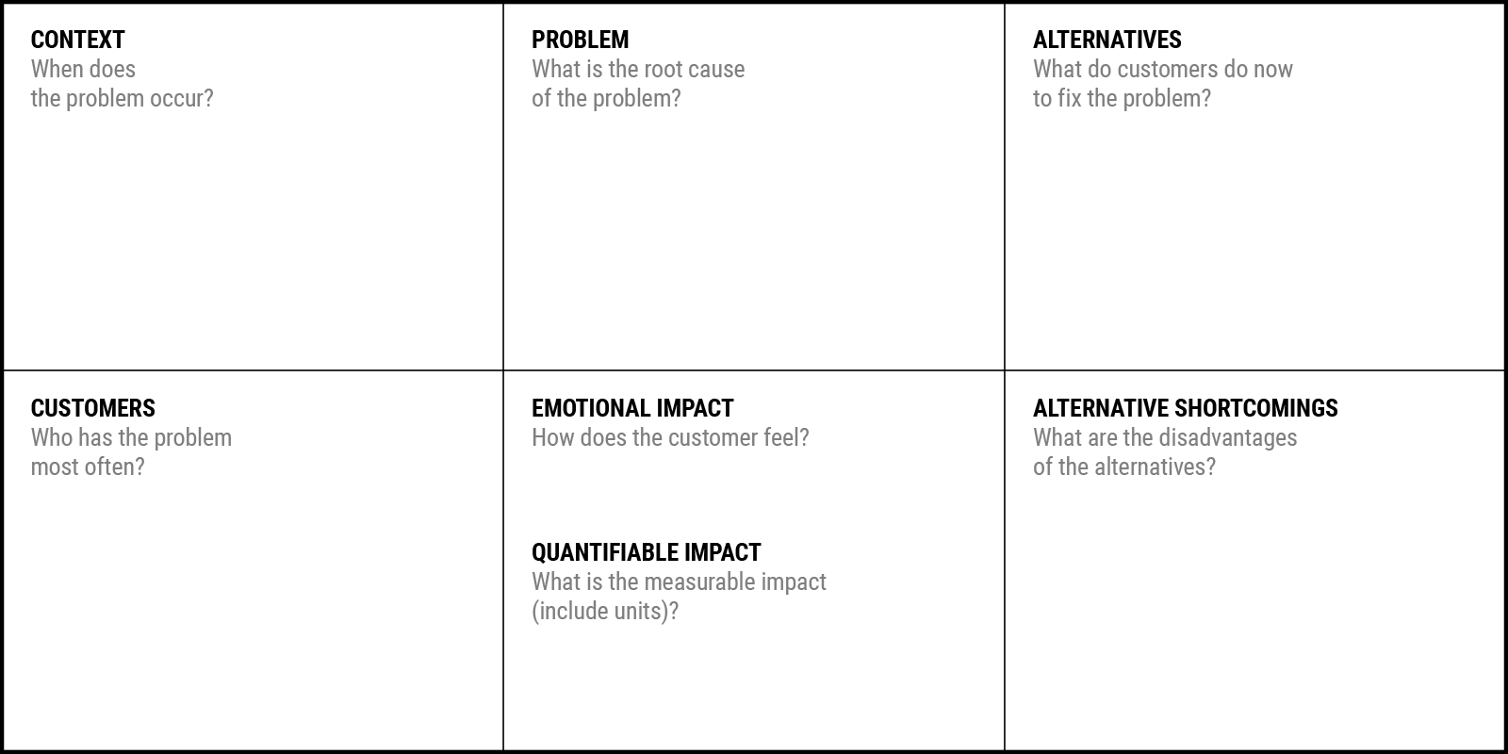
Problem Statement Canvas
YUKTI Proto ID:
Idea/Innovation Title: Nanofibers based edible coating for fruits and vegetables
Date of Submission:
Who is your Customer Segment: Farmers, food packaging companies, Consumers
Prepared By:
Contact No: 9760907526
Your Answer: "The quandary of fruit and vegetable waste materializes throughout the agricultural supply chain due to factors encompassing pre-harvest, post-harvest, transportation, and consumption stages."
Your Answer: The primary etiology resides in the intricate interplay of biological, logistical, and behavioral determinants within the agro-ecosystem, precipitating suboptimal protocols for harvesting, post-harvest management, storage, and utilization."
Your Answer: "Customers can contribute to resolving the issue by adopting responsible purchasing decisions, minimizing overbuying, and embracing proper storage practices for fruits and vegetables."
Your Answer: "Fruit and vegetable waste may induce customer guilt and frustration due to ethical and environmental concerns."
Your Answer: "Producers in the agricultural supply chain often encounter the most pronounced challenges pertaining to fruit and vegetable waste due to intricate factors influencing cultivation, harvesting, and distribution."
Your Answer: "Alternative approaches to mitigate fruit and vegetable waste, such as increased preservation techniques or enhanced distribution systems, may entail higher energy consumption and potential trade-offs in nutritional quality."
Your Answer: “Food losses and waste amounts to USD 680B in developed and USD 310B in developing countries every year."

Slide 4
Assignment 2: Empathy Map/Opportunity Canvas Preparation and Submission of an Empathy Map/ Opportunity Canvas Sheet for Validation of your Prototype/Innovation Find few Sample empathy canvas copy for Reference and a Blank Format for Fill up and Upload of the same (jpg or pdf) in the YUKTI Portal.
Complete Guidance of Preparing Empathy Canvas with Templet Available at https://miro.com/miroverse/empathy-map-canvas-1/
Opportunity Canvas at

Slide 5
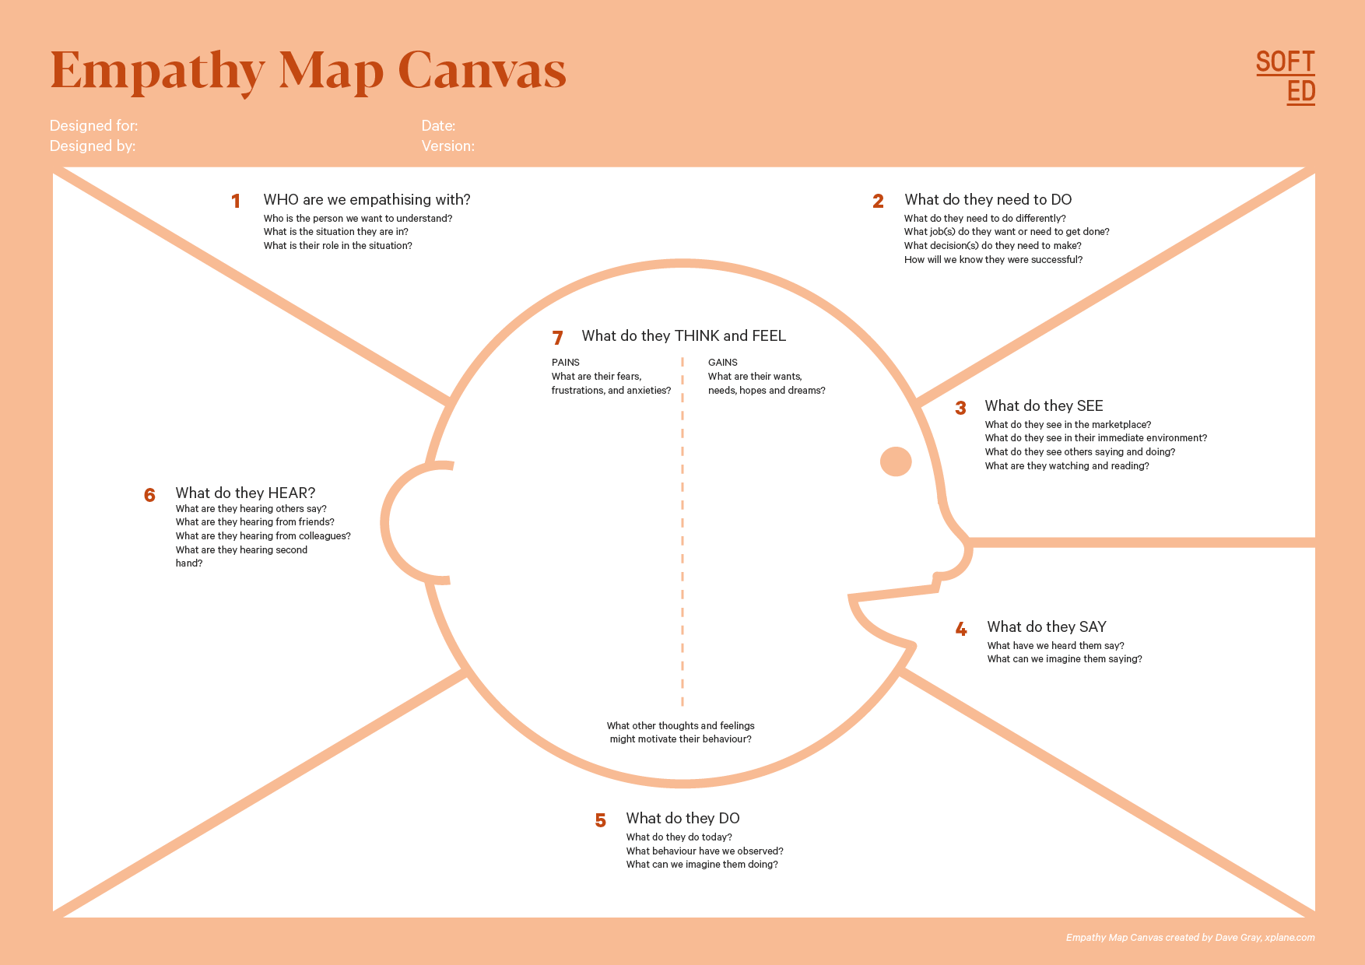
Who is your Customer Segment:
Idea/Innovation Title:
Designed By:
Date of Submission:
YUKTI Proto ID:
Your Answer:
,
Your Answer:
"They need to
(i) adopt innovative storage and distribution practices,
(ii) efficiently handle logistics and minimize waste.
"We empathize with (i) the farmers who strive to manage post-harvest losses
(ii) navigating complex supply chains and unpredictable conditions, and
(iv) success will be evident through reduced food loss, improved resource utilization, and enhanced economic viability."
(iii) playing a pivotal role in sustainable food production."
(iii) decide on optimal harvest timings and
post-harvest interventions.
"They perceive (i) fluctuating market demands and consumer preferences
Your Answer:
Your Answer:
(iii) industry trends towards sustainability
They receive auditory inputs including (i) discussions on sustainable agricultural practices and waste reduction across the industry
(ii) challenges in storage facilities and transportation infrastructure
(ii) conversations about food waste and its environmental implications from friends
Your Answer:
Your Answer:
"They experience (i) concerns over income stability due to yield losses and post-harvest wastage, along with frustrations about inefficient distribution systems;
(ii) aspirations for improved harvest yield, reduced waste, and sustainable practices that align with their values and long-term goals."
(iv) monitoring market trends, technological advancements, and consumer behaviors
Your Answer:
(iii) insights on improved post-harvest handling techniques from colleagues
(iv) indirect insights through industry reports and news."
They express (i) concerns about yield losses and supply chain inefficiencies
Your Answer:
The prospect of enhanced market competitiveness through reduced waste and improved product quality may also drive their behavior."
(ii) potential discussions on adopting advanced preservation methods and optimizing distribution networks."
Your Answer:
They currently (i) implement traditional storage methods, (ii) exhibit patterns of discarding visually imperfect produce
(iii) could potentially adopt smart storage technologies and participate in community-driven efforts to minimize food waste.

Slide 6
Assignment 3: Business Model Canvas Preparation and Submission of an Business Model Canvas Sheet for Business Opportunity Validation your Prototype/Innovation Find few Sample Business Model Validation copy for Reference and a Blank Framework for Fill up and Upload of the same (jpg or pdf) in the YUKTI Portal.

Slide 7
Idea/Innovation Title:
YUKTI Proto ID:
Partnering with farmers and food packaging companies
Research and Development: Continuously researching and refining the nanofiber coating formulation. Experimenting with different ratios of silk fibroin, honey, and curcumin for optimal results.
Supply Chain Management and Customer Engagement: Sourcing raw materials for the coating's production. Engaging customers through marketing, sales, and support channels.
Data Monitoring and Analysis: Implementing data tracking systems to monitor sales, customer feedback, and product performance. Analyzing collected data to assess business performance and identify areas for improvement.
why a customer would choose your product or service.
Research Institutions and Universities:
Collaborating with academic institutions for cutting-edge research in biomaterials and nanotechnology.
Leveraging their expertise to continuously improve the coating's effectiveness.
Suppliers of Raw Materials:
Establishing partnerships with suppliers of silk fibroin, honey, and curcumin.
Ensuring a steady supply of high-quality ingredients for nanofiber coating production.
Nanofiber edible coating, derived from silk fibroin, honey, and curcumin.
Enhances produce quality and addresses the pressing challenge of post-harvest waste.
Protein based edible coating which is non toxic, unlike chemical based coating
Protein used is derived from silk cocoons which is the waste of silk industry: “Waste to Wealth”
.
Customer Engagement and Support:
Employing digital marketing strategies to reach target customers effectively.
Providing excellent pre and post-purchase support for inquiries, technical assistance, and feedback.
Relationship and Experience:
Establishing a personalized and trust-based relationship with customers.
Aiming for customers to feel valued, supported, and empowered to make sustainable choices.
Farmers and Agricultural Producers:
Those seeking to enhance the quality and shelf-life of their produce.
Value from reduced post-harvest losses and improved marketability.
Distributors and Retailers:
Entities interested in delivering fresh and high-quality fruits and vegetables to consumers.
Value through extended shelf-life, reduced waste, and improved customer satisfaction.
Consumers:
Individuals looking for fresher and longer-lasting fruits and vegetables.
Value from increased freshness, reduced food waste, and healthier choices.
Environmental Organizations and Regulatory Bodies:
Entities focused on sustainable practices and reducing food waste.
Value from endorsing an innovative solution contributing to environmental conservation.
Research and Development Infrastructure: State-of-the-art laboratories equipped for formulation and testing of nanofiber coatings. Skilled researchers and scientists proficient in biomaterials, nanotechnology, and food science.
Production and Distribution Setup: Manufacturing facilities capable of producing nanofiber coatings at scale. Efficient distribution network with warehousing, logistics, and delivery capabilities.
Distribution Partnerships:
Collaborating with agricultural supply chains, distributors, and retailers.
Leveraging established networks to efficiently reach farmers, distributors, and end consumers.
Online and Offline Sales Channels:
Utilizing e-commerce platforms for direct-to-consumer sales.
Establishing partnerships with brick-and-mortar retailers for in-store availability.
Raw Materials Procurement: Silk fibroin, honey, and curcumin are essential ingredients, which may involve costs for sourcing and quality control.
Research and Development Expenses: Investments in research facilities, equipment, and skilled personnel for ongoing innovation.
Distribution Costs: Expenses related to distribution, logistics, and transportation of the nanofiber coating to various stakeholders.
Marketing and Promotion: Costs for advertising, digital marketing, and branding activities to create awareness and drive sales.
Commission or Partnership Fees: Potential fees associated with partnerships or distribution channels that take a percentage of sales.
Product Sales:
Generating revenue through the sale of the innovative silk fibroin-honey and curcumin-based electrospun nanofiber edible coating.
Offering different product variants and sizes to cater to diverse customer needs.
Subscription Models or Licensing Agreements:
Exploring subscription-based models for regular supply to distributors and retailers.
Considering licensing arrangements for wider adoption of the technology in the industry.

Slide 8
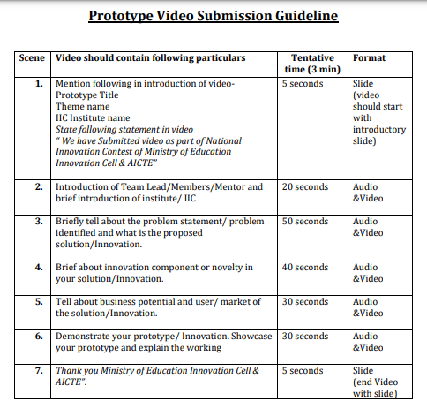
Assignment 4: Recent Images of Prototype/Innovation
Place at least two –three recent images of your product/innovation & Place the URL of maximum 3 minutes video on your product/innovation. Refer video preparation guideline
Note:
If video contains the IP component then video may be uploaded in the google drive and access shall be given to yukti@aicte-india.org
Due to ease of accessibility, the video may be uploaded on YouTube and video link should be provided.
Only provide video URL/Link and no video should be sent in email to MIC

Slide 10
Assignment 5: Submit Brief Presentation on your Innovation and Business Opportunity Plan

Slide 11
1. The Overview
Create a very high-level overview of your product or service
We are a startup company supported by TIDES Bio incubator IIT Roorkee. We're here to develop innovations in healthcare and the food and agriculture sectors.
"Revolutionizing Health and Nutrition: Our Startup Journey with TIDES Bio incubator, IIT Roorkee"
LEARN NOW

Slide 12
2. The Problem
What problem are you trying to solve? Is it really a problem?
"Addressing Challenges Head-On: Reducing Food Waste and Enhancing Produce Quality, Elevating Shelf-Life, and Reducing Waste: "
"Meet Our Ideal Beneficiary: Innovators in Agriculture and Health Industries"
How the innovation/startup solves it - concept & key elements.
"Innovative Solution Unveiled: Transforming Agriculture and Health with Cutting-edge Nanofiber Coating"
LEARN NOW

Slide 13
3.The Solution
Describe how are you solving the problem
Our Nanofiber Coating Technology for Fresher Produce
"Empowering a Greener Future with Enhanced Produce Quality."
Include explainer videos, images, demos, product screenshots
LEARN NOW

Slide 14
4. The Product/Service
Describe how are you solving the problem
Include explainer videos, demos, product screenshots
Include PoCs.Include testimonials of actual customers, if any.
(i) Value Proposition of Product/Service: Our innovative nanofiber edible coating, derived from silk fibroin, honey, and curcumin, extends the shelf-life of fruits and vegetables by forming a protective layer that inhibits microbial growth. This breakthrough technology enhances produce quality and addresses the pressing challenge of post-harvest waste.
(ii) Benefits/Impact Created:
Waste to Wealth: We use protein from silk cocoons which is the waste of silk industry.
Environmental Impact: By curbing food waste, we contribute to reducing carbon emissions and conserving resources.
Economic Viability: Farmers and distributors benefit from reduced losses, translating to improved profitability and economic sustainability.
Protein based edible coating which is non toxic, unlike chemical based coating
LEARN NOW

Slide 15
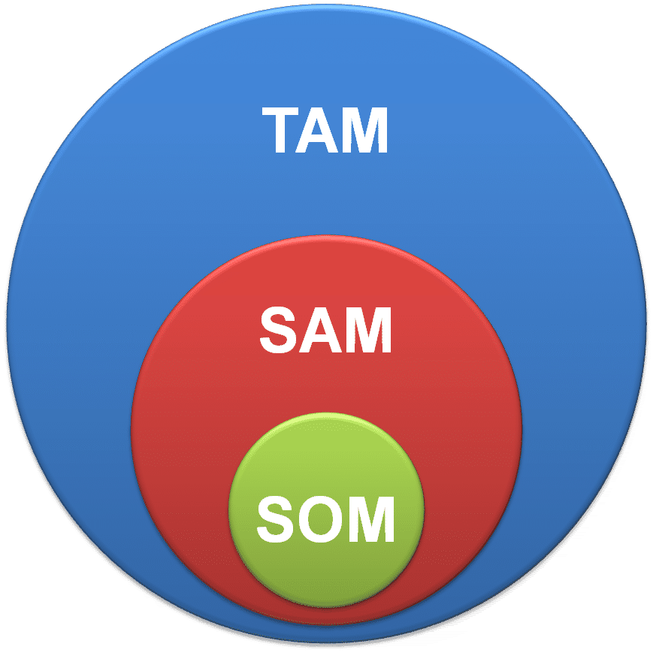
5. Market & Opportunity
Describe/Highlight the size of your target market
Total Addressable Market (TAM)
Based on extensive research, the TAM for our nanofiber edible coating spans the global agricultural and food industries, estimated to be valued at $5 trillion as of 2022. This figure includes all potential customers who could benefit from enhanced produce quality and reduced waste.
Serviceable Addressable Market (SAM)
Our SAM, focusing on the Indian Landscape is estimated to be valued at $435 Billion as of 2022.
Service Obtainable Market (SOM)
Expecting to capture 3-5% of SAM, we get $13.05-21.75 Billion market.
(
Target Market: We are targeting the "Super Fresh Produce Retailers" segment. This segment includes premium supermarkets, organic stores, and health-conscious consumers who prioritize freshness and quality.
Primary Research Data: Surveys and interviews with 500+ retail managers and distributors. Industry reports and trade publications analysis.
Secondary Research Data:Data from agricultural associations and government agencies. Competitor analysis for market gaps and niches.
$5 trillion : Global agriculture and food industry as of 2022.
$435 Billion: Indian agriculture and food industry as of 2022.
LEARN NOW
$13.05- $21.75 Billion: Expected to capture 3-5% of SAM. (Initial stage of development

Slide 16
6. The Technology/Innovation
Describe the technologies you are using to solve the problem
Stage of the development of solution
TRL: 5/6
Highlight the Intellectual Property (IP) component
Electrospun edible silk based composite nanofibers and dip coating process and product for packaging perishables (fruits, vegetables etc).
Silk fibroin-honey-turmeric blend nanofibers coating & dip coating for industrial & local vendors respectively
1.R&D Phase: Optimize nanofiber formulation and coating techniques.
2. Prototyping and Testing: Trials on various produce, collaborate with research institutions.
3. Pilot Testing: Engage select retailers, gather real-world data.
4. Refinement and Scale-Up: Incorporate feedback, establish production facilities.
5. Market Expansion: Launch production, collaborate with distributors.
6. Continuous Improvement: Monitor feedback, explore partnerships.
7. International Expansion: Expand based on success, adapt technology globally.
LEARN NOW

Slide 17
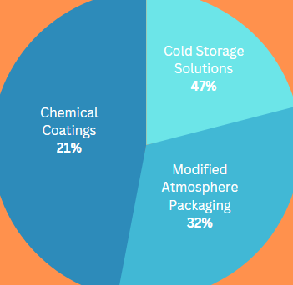
7. Competitive Landscape
What are the alternative solutions available in the market?
Tell about what sets you apart from competitors
Natural Ingredients: Our nanofiber coating utilizes silk fibroin, honey, and curcumin, offering a natural and sustainable solution.
Antimicrobial Efficacy: The combination of curcumin and honey provides enhanced antimicrobial properties, setting us apart from chemical coatings.
Active Preservation: Unlike passive solutions, our coating actively inhibits microbial growth, leading to longer-lasting produce.
Protein based non toxic edible coating.
Mention Potential Competitors
Chemical Coatings: Traditional chemical-based coatings that may have limited natural ingredients. (21% market share)
Modified Atmosphere Packaging: Packaging solutions to extend shelf-life, but without active preservation benefits. (32% market share)
Cold Storage Solutions: Cooling systems to delay spoilage, but not as effective as active preservation methods. (47% market share)
Mention Competitive Advantage of your Product over others
Natural Ingredients, Active preservation, enhanced microbial power
Highlight Barriers to entry – Key partnerships, IP
Key Partnerships: Collaborations with research institutions and distributors provide a competitive edge through expertise and market access.
Intellectual Property (IP): Patented nanofiber coating formulation safeguards against replication.
Technological Expertise: Specialized knowledge in nanofiber creation and coating application acts as a barrier for new entrants.
LEARN NOW
What are Opportunities for collaboration and co-creation
Collaborating with agricultural research institutions to optimize coating performance.
Partnering with retail chains to conduct joint trials and gather real-world data.
Co-creating with packaging companies to explore integrated solutions for extended shelf-life.
Engaging with sustainability-focused organizations to promote our eco-friendly approach.

Slide 18
8. Business Model
What is your revenue model?
Source of Revenue:
Our revenue model is primarily based on product sales:
1. Direct Sales: Selling our nanofiber coating to
retailers, distributors, and directly to consumers.
2. Subscription Model: Offering subscription
packages to retailers for regular supply.
3. Licensing Agreements: Exploring partnerships to
license our patented technology for wider adoption.
4. Premium Services: Providing value-added
services like customized coating formulations for
specific produce types.
Viable Business Model:
• Our focus on sales, subscription, and licensing
agreements ensures multiple revenue streams.
• While profitability may not be immediate, our
strategic partnerships, expanding customer
base, and increasing demand project
sustainable growth.
• We are committed to optimizing operational
efficiency and maintaining a sustainable
financial trajectory that aligns with our long
term business goals.
LEARN NOW

Slide 19
9. Traction
Customer Validation
• Mention any business traction you received so far for
your innovation/product/service
Received positive feedback from beta testers on the coating's effectiveness and improved produce quality.
Engaged in discussions with a major startup for potential distribution.
• Talk about Key Performance Indicators (KPIs)starting
from product development to product launch and
growth of business
Product Development Phase: Formulation optimization timeline., Successful completion of lab trials and effectiveness assessment.
Pre-Launch Phase: Number of pre-orders or letter of intents received, Beta sign-up rate for product testing.
Product Launch and Growth:
KPI: Sales growth rate and customer acquisition rate.
KPI: Customer retention rate and satisfaction surveys.
KPI: Month-on-month revenue growth rate.
Month on month growth rate
Our target is to achieve a steady month-on-month growth rate of at least 15% during the first year of product launch. This growth will be monitored closely and strategies adjusted as needed to meet or exceed this target.
Pre orders Pre-orders
Targeting a minimum of 500 pre-orders before product launch.
Letter of Intent
Aiming for at least 3 strategic partnerships expressed through letters of intent.
Beta sign ups
Targeting 1000+ beta sign-ups from interested users and potential partners.
Key Partnerships/Licenses
Engaging with at least one major distributor and exploring licensing opportunities with research institutions.
LEARN NOW

Slide 20
10. Resource Mobilisation Plan
What is your Resource Mobilization Strategy and What you have done so far?
Production Plan?
Our production plan involves multiple stages, from raw material procurement to coating application and quality control. We are implementing a phased approach to ensure scalability and consistent quality.
Resource Requirement – Human & Technology & Infrastructure/
Facility Human Resources:
• Research Scientists: Specialized in nanofiber technology and coating formulation.
• Production Team: Skilled technicians for coating application and quality control.
• Sales and Marketing: Professionals to promote the product and engage with customers.
Technology and Infrastructure:
• Laboratory Facilities: Equipped for nanofiber creation and coating testing.
• Production Machinery: Electrospinning equipment and coating application tools.
• Quality Control: Sensors and equipment for evaluating coating effectiveness.
Financial/Fund Raised/received from Alternatives Sources
Govt. Grant, Friends, Bootstrapping, Bank loans etc.
BIRAC Grants: Secured a research grant from a government agency to support initial R&D.
LEARN NOW

Slide 21
11. Way forward Strategy
What is your implementation strategy in short-term, midterm and long-term?
Incubation Unit: Joining a reputable incubation program to gain mentorship, access to resources, and networking opportunities.
Prototype Development: Focus on finalizing the nanofiber coating prototype and conducting comprehensive testing.
Mid term if any?
Product Launch: Launch the nanofiber coating product in the market, targeting Super Fresh Produce Retailers.
Market Enrollment: Expand distribution and build partnerships with retailers, distributors, and potential customers.
Equity Dilution: Consider equity dilution to secure further funding for scaling operations and market penetration.
Incubation and Acceleration: Participate in accelerator programs for growth-oriented mentorship.
Long term if any?
Investor Onboarding: Attract angel and venture capital partners for equity or debt funding to support expansion.
IPO Consideration: Evaluate the potential of an Initial Public Offering (IPO) to raise substantial capital for expansion.
Strategic Partnerships: Explore mergers and acquisitions (M&A) opportunities with aligned industry players.
Global Expansion: Establish a presence in international markets through strategic alliances and partnerships.
LEARN NOW

Slide 22
12. The Team
Show the people behind the idea and briefly describe their role
Founders: Dr. P. Gopinath
Co-Founder: Mr. Dravin Pratap Singh
Explain the unique value each person brings to the startup:
Entrepreneurial Expertise: Dr. Gopinath's extensive experience in entrepreneurship and mentorship infuses the startup with a visionary outlook, guiding its strategic direction with valuable insights.
Strategic Leadership: As a seasoned leader, he leverages his industry network to align business objectives and execution, promoting sustainable innovation and fostering growth.
Mr. Singh's exceptional proficiency in Food, Nanonutraceuticals, Nanofood Therapeutics, and Agriculture Nanotechnology establishes a robust technical base for the startup
Talk about their passion for the project and why they decided to work for a startup:
Dr. P. Gopinath (Founder and Mentor): Driven by a fervent commitment to innovation, he chose the startup path to directly impart expertise and create impactful change.
Mr. Dravin Pratap Singh (Co-founder and PhD Scholar): Passionate about converting science into solutions, he's drawn to startups for their agility in translating ideas into real-world impact.
Team member’s history
Educational: Prof. P. Gopinath, Head, Centre for Nanotechnology
Mentor and Founder of the company
Mr. Dravin P. Singh: PhD Scholar
Areas of expertise: Food and Agriculture Nanotechnology
LEARN NOW

Slide 23
13. Contact
Leave your contact details and let people know how to reach you quickly
Contact no: 979760907526, 9410193513
Email id: nanobiogopi@gmail.com
LEARN NOW

Slide 24
Thankyou

